Slide 1
Basketball Game
Presented by:
Abdullah Al Shafi
Roll:1807004

Slide 2
Control Buttons
K => Move camera forward
I => Move camera backward
J => Move camera left
L => Move camera right
U => Move camera up
H => Move camera down
S => Move player forward
X => Move player backward
Z => Move player left
C => Move player right
Left Button => Rotate player anticlockwise
Right Button => Rotate player
clockwise
Upper Button => Increase initial velocity
Down Button => Decrease initial velocity
Enter => Fire the ball
1 => Turn on/off pointLight
2 => Turn on/off directionalLight
3 => Turn on/off spotlight
4 => Turn on all lights
5 => Turn off all lights
6 => Only ambient light
7 => Only diffusive light
8 => Only specular light

Slide 3
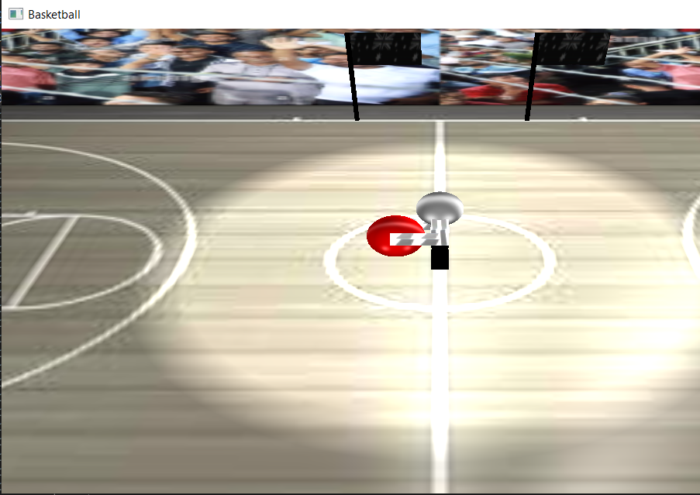
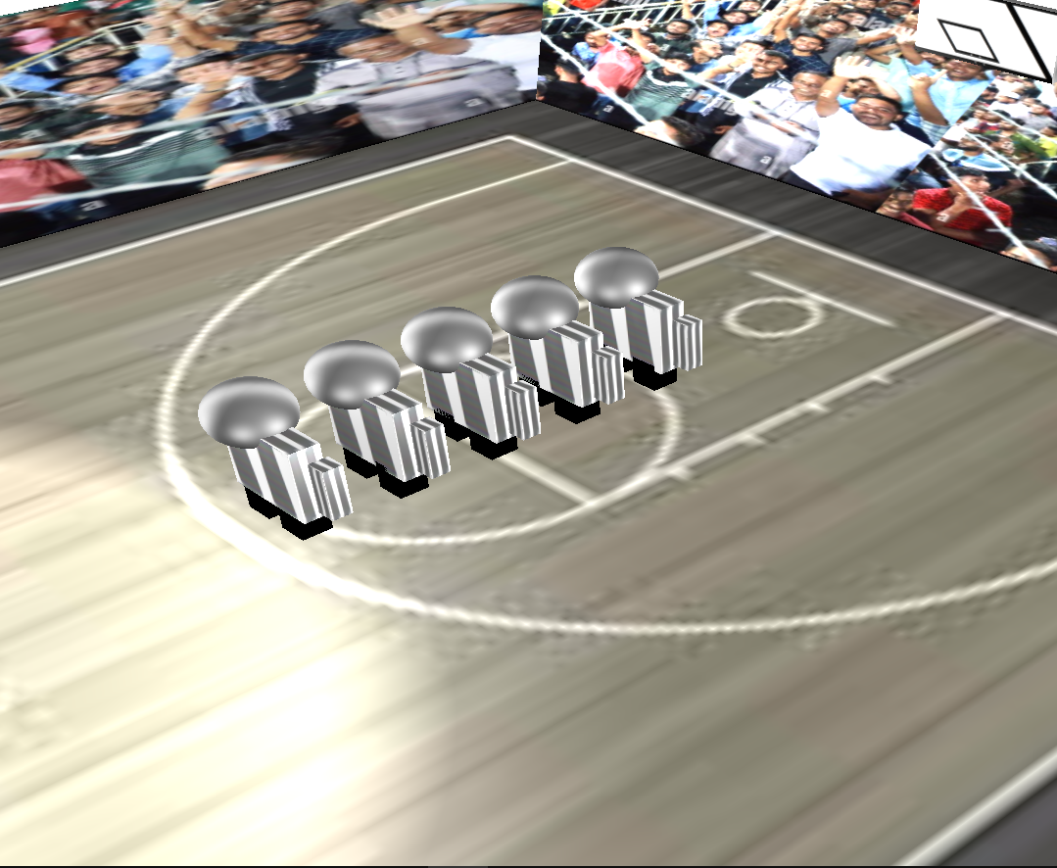
Players
Figure: The player currently playing
Figure: The players next to play

Slide 4
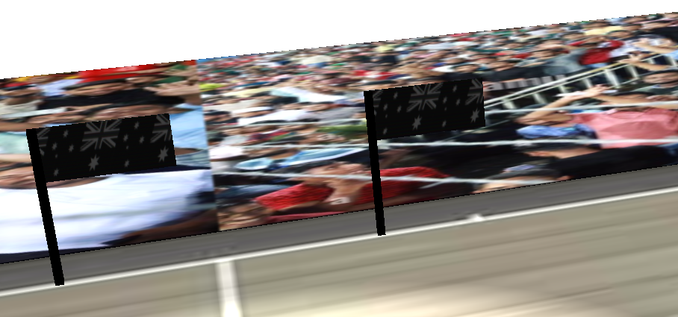
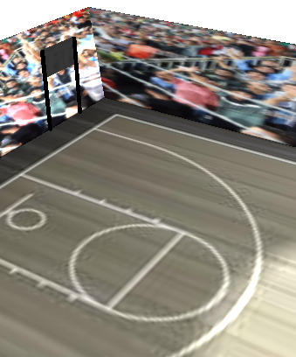
Flag and Scoreboard
Figure : Flag
Figure : Scoreboard

Slide 5
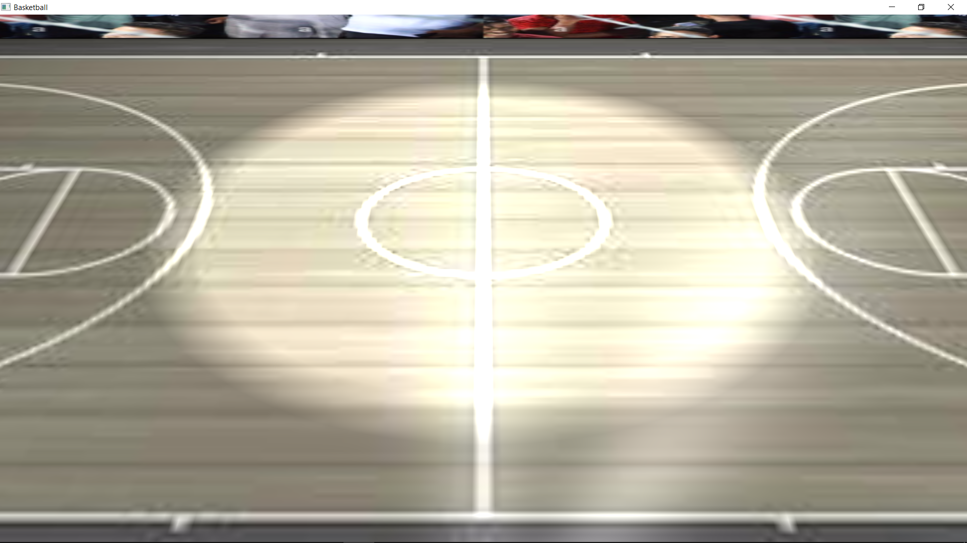
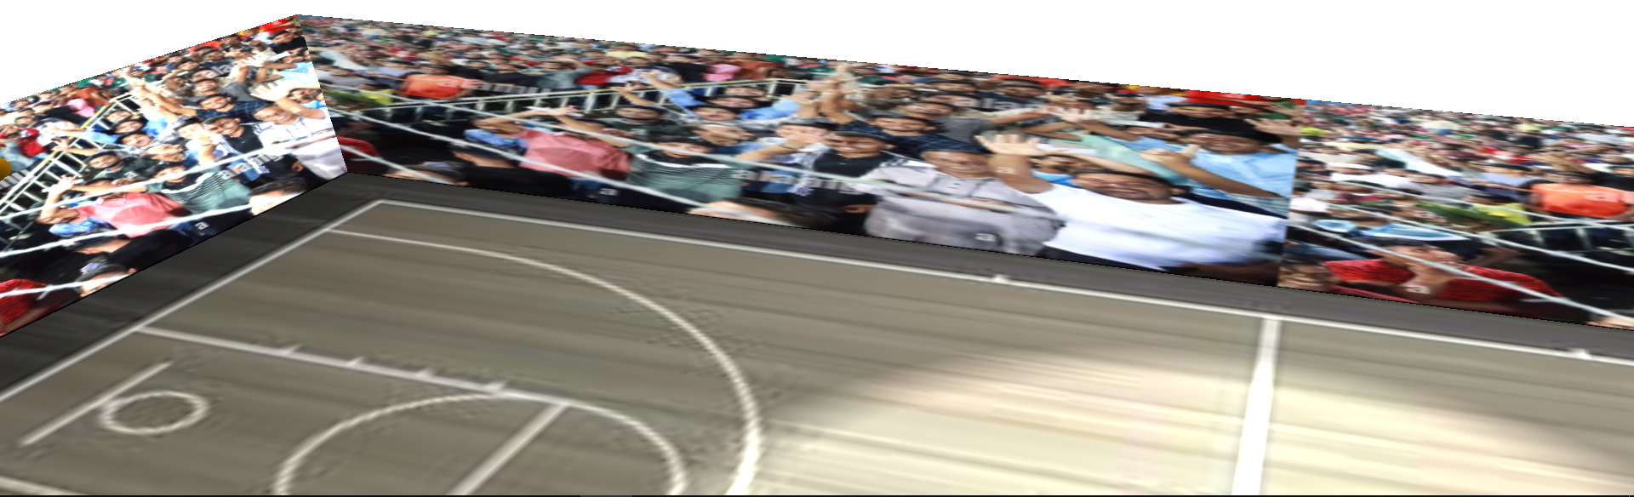
Court and Gallery
Figure : Court
Figure : Gallery

Slide 6
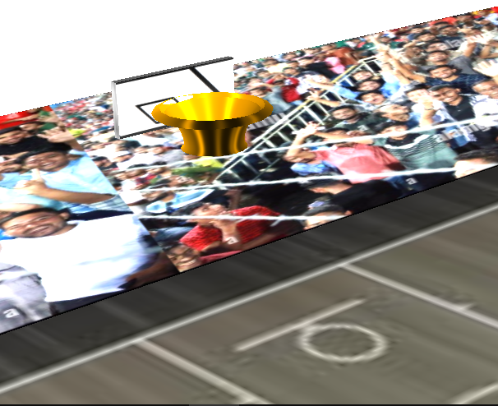
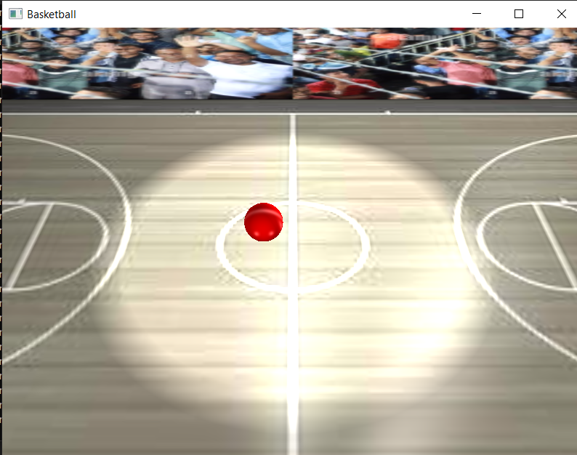
Basket and ball
Figure : Basket
Figure : Ball

Slide 7
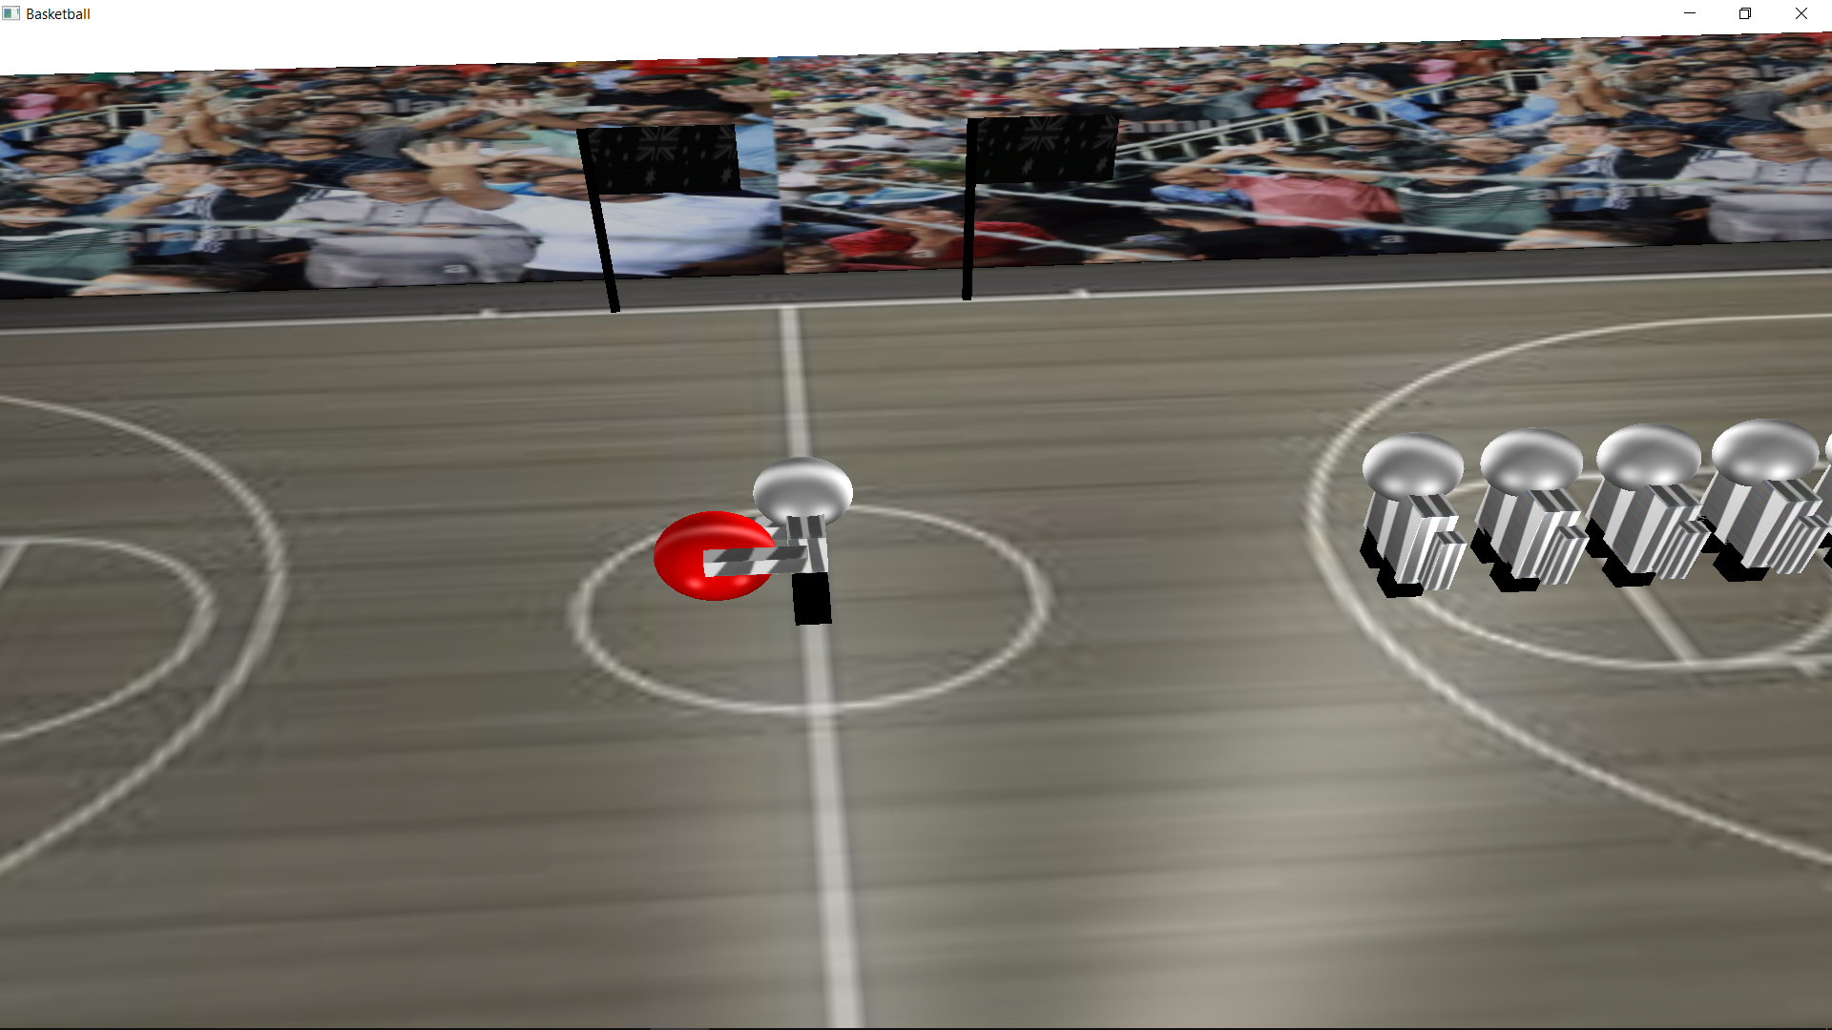
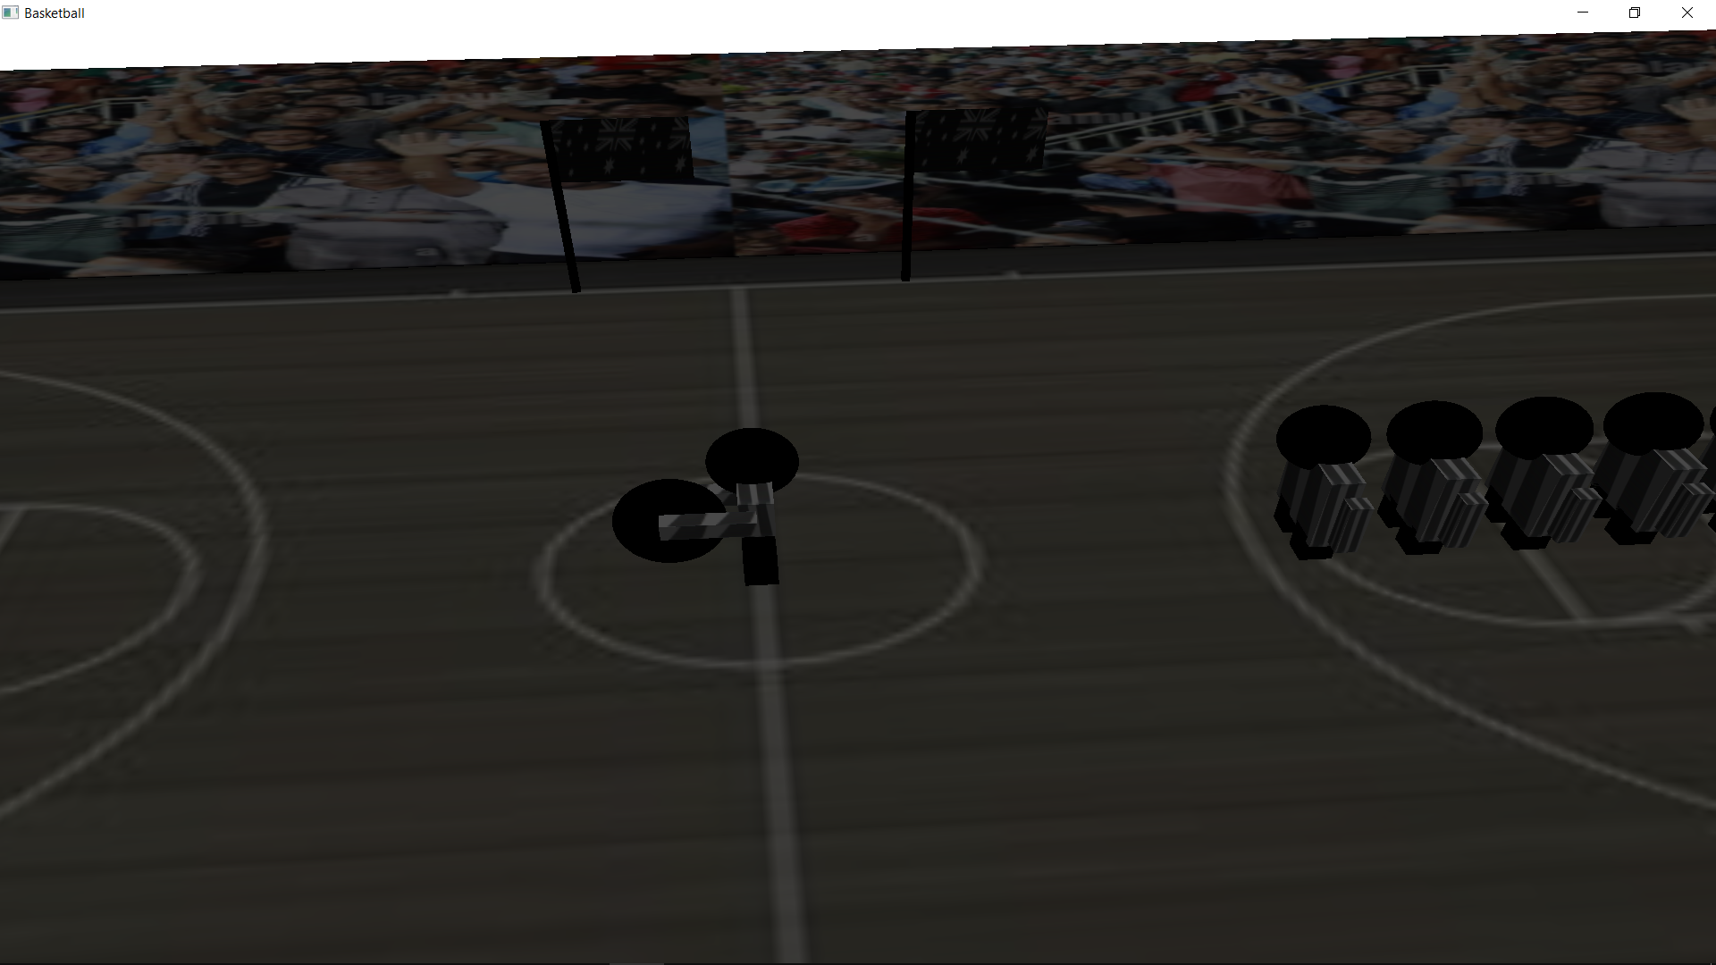
Lights
Figure : PointLight only
Figure : DirectionalLight only

Slide 8
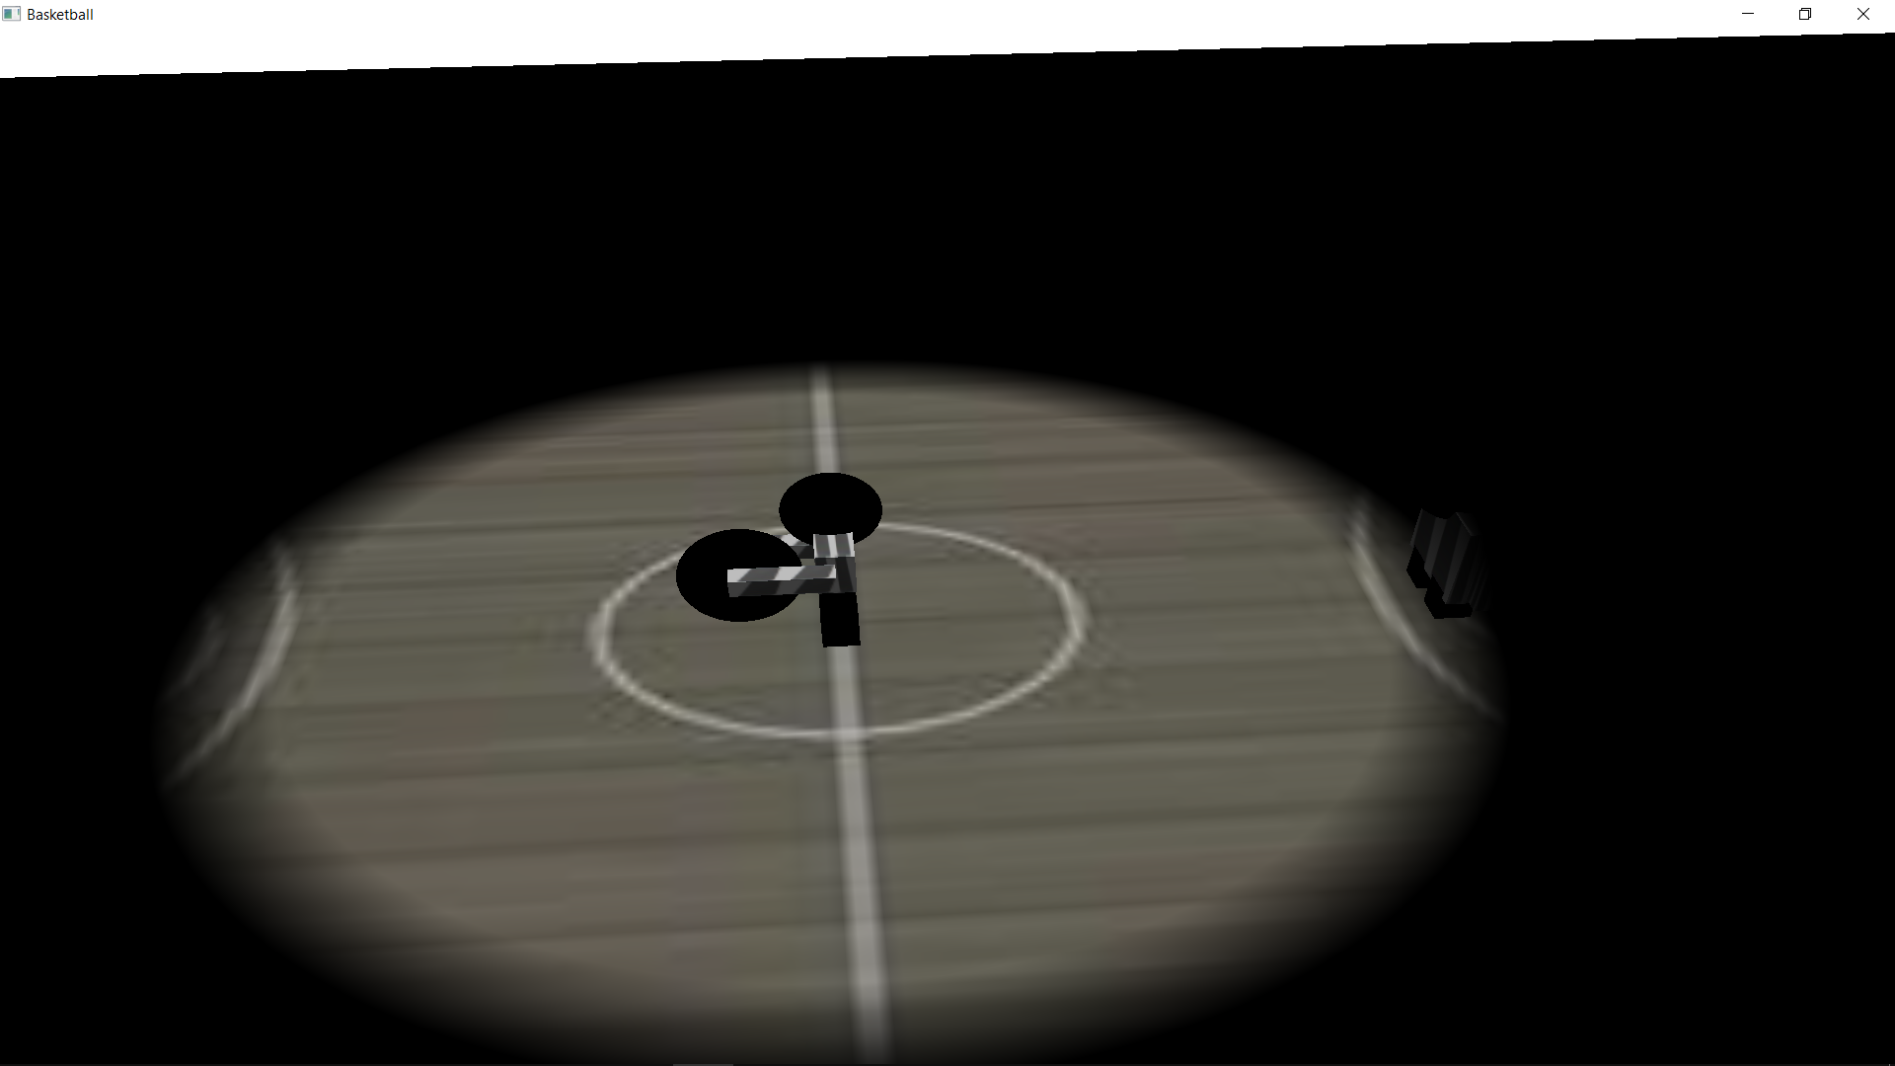
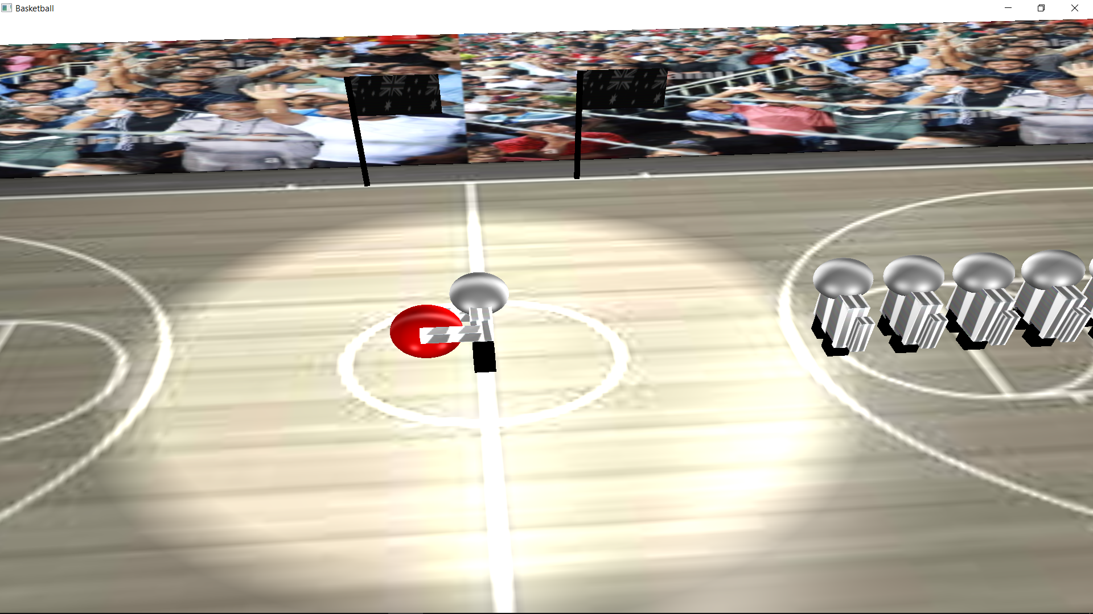
Lights
Figure : Spotlight only
Figure : All lights on

Slide 9
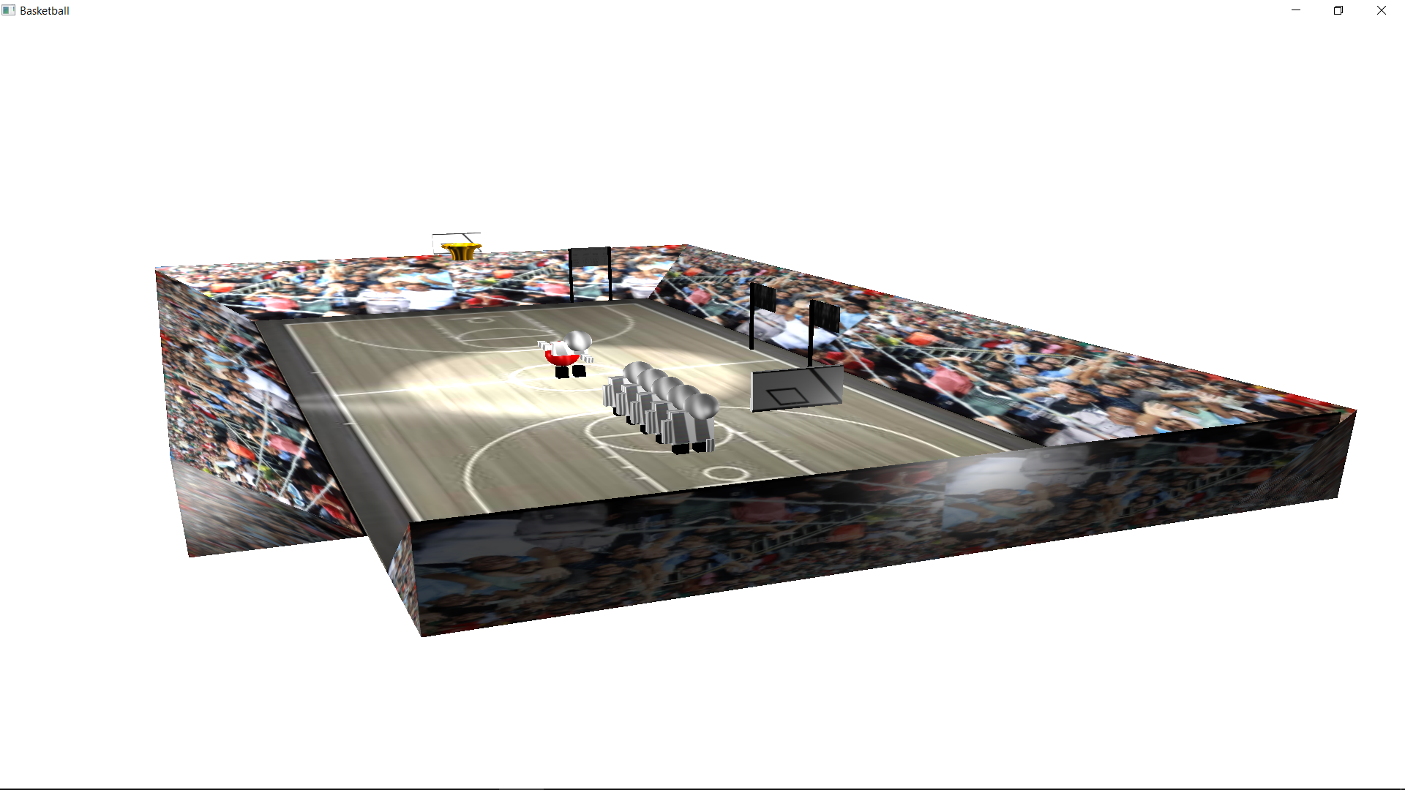
Bird’s eye view

Slide 10
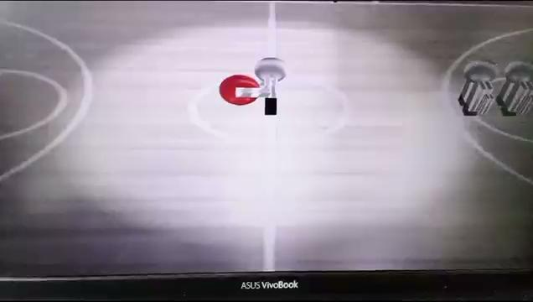
Player movement
If player go in front of the small ring,then he is disqualified.

Slide 11
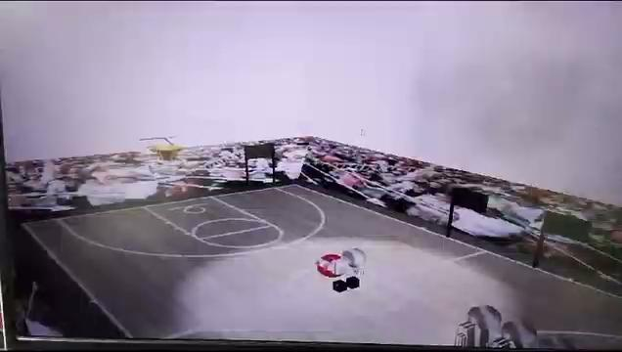
Ball Throwing

Slide 12
Further improvement
The score is showing in the console.
It would be better and realistic if it can be shown in the scorecard(scene).

Slide 13
Thank you

